Slide 1

Computer Networking CCNA 200-301

Slide 2
Course Outline
Module 1 Network Fundamentals
Explain Role and Function of Network Components : Routers, Switches, Firewall, IPs, WLC, AP, Endpoints, Servers
OSI Reference Model and TCP/ IP Model
IPv4 Addressing and Subnetting
IPv6 Addressing and IPv6 address Types
Module 2 Basic Configuration of Router and Lan Switching
Modes of Router
Basic Security of Router (Passwords) and Configuration of IP on Router
Point to Point connectivity of Routers
Configure and Verify Layer2 Discovery Protocols (CDP and LLDP)
Basic Operation of Switch (Collision Domain and Broadcast Domain)
Spanning-tree Protocol (PVST, RSTP), Port states and Port fast
Configure and Verify VLANS and Inter-switch Connectivity (Trunk ports, 802.Iq)
Ether-channel
Cisco Wireless Architecture and AP modes
Configuration of Wireless Lan Controller and AP Using GUI (WPA, WPA2, PSK)

Slide 3
Course Outline
Module 3 IP Routing
Static Routing with IPv4 and IPv6, floating static route and Default route
Configure and Verify Single area OSPF
DR and BDR election. Point to point, Concept of Router-ID
Module 4 IP Services
NAT
Configure and Verify NTP
Describe DNS, SNMP, Syslog, QOS, Function of FTP and TFPF in network
Configuration of DHCP, telnet and SSH
Describe the function of First hop redundancy protocol (HSRP, VRRP, GLBP)

Slide 4
Course Outline
Module 5 Security Fundamentals
Configure and Verify Access control List
Describe VPN Technologies (Site-to-site VPN and Remote access VPN)
Describe Authentication, Authorization and Accounting (AAA)
Configure Port Security, DHCP Snooping and Dynamic ARP Inspection
Module 6 Automation and Programmability
Explain how automation impacts network management
Compare traditional network with controller-based networking
Compare traditional campus device management with Cisco DNA Center enabled device Management.

Slide 5
Module 3 IP Routing
Static Routing with IPv4 and IPv6, floating static route and Default route
Configure and Verify Single area OSPF
DR and BDR election. Point to point, Concept of Router-ID

Slide 6
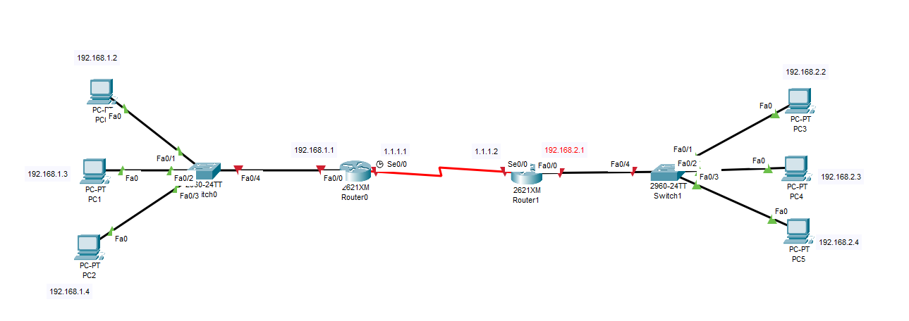
Will this Network Communicate?
This will not communicate because we need to run routing protocol on it.
Routing protocol is need when we connect two Networks

Slide 7
Routing Protocols
What is Routing?
Routing is the process of selecting a path for data packets to travel from the source to the destination across networks.
Key Components:
Routers
Routing Tables
Protocols:
A protocol in computer networking is a set of rules that devices follow to communicate and exchange data.
Types of Routing Protocols:
Main Types:
Static Routing Protocols
Dynamic Routing Protocols

Slide 8
Routing Protocols
Static Routing Protocol
Routes are manually configured by the network administrator.
Fixed paths
No overhead for route updates
Time Consuming
Simple and secure
Requires manual updates in case of network changes
Example:
Configuration of a route in a small, stable network
Dynamic Routing Protocol
Routes are automatically adjusted based on network conditions.
Requires routing protocols to operate
Automatically updates routes
Consumes bandwidth for updates
Examples:
RIP (Routing Information Protocol)
OSPF (Open Shortest Path First)
EIGRP (Enhanced Interior Gateway Routing Protocol)
BGP (Border Gateway Protocol)

Slide 9
Routing Protocols
When to Use Static Routing?
Ideal Scenarios:
Small, simple networks
High-security environments
Networks with no frequent topology changes
When to Use Dynamic Routing?
Ideal Scenarios:
Large, complex networks
Networks requiring frequent updates
**********************************************************************************************************************
Difference between Routing and Routed:
Routing
Forwarding the packet from one Network to another Network is called routing.
The process of determining the path for data packets in a network.
Concerned with the decision-making process (how and where to send data).
Routed
Refers to data packets that are forwarded across the network.
Refers to the actual data or payload being transmitted.

Slide 10
Static Routing Practical 1

Slide 11
Static Routing Lab
R1
Router>enable
Router#configure terminal
Router(config)#interface FastEthernet0/0
Router(config-if)#ip address 192.168.1.1 255.255.255.0
Router(config-if)#no shutdown
Router(config-if)#exit
Router(config)#interface Serial0/0
Router(config-if)#ip address 1.1.1.1 255.0.0.0
Router(config-if)#no shutdown
Router(config-if)#exit
Router(config)#ip route 192.168.100.0 255.255.255.0 4.1.1.2
Router(config)# ip route 192.168.150.0 255.255.255.0 1.1.1.2
R2
Router>enable
Router#configure terminal
Router(config)#interface FastEthernet0/0
Router(config-if)#ip address 192.168.2.1 255.255.255.0
Router(config-if)#no shutdown
Router(config-if)#exit
Router(config)#interface Serial0/0
Router(config-if)#ip address 1.1.1.2 255.0.0.0
Router(config-if)#no shutdown
Router(config-if)#exit
Router(config)#ip route 192.168.50.0 255.255.255.0 4.1.1.1
Router(config)#ip route 192.168.150.0 255.255.255.0 3.1.1.1
Destination Network
Next Hop
R1(config)#ip route 192.168.2.0 255.255.255.0 1.1.1.2
R2(config)#ip route 192.168.1.0 255.255.255.0 1.1.1.1
Next Hop
Destination Network

Slide 12
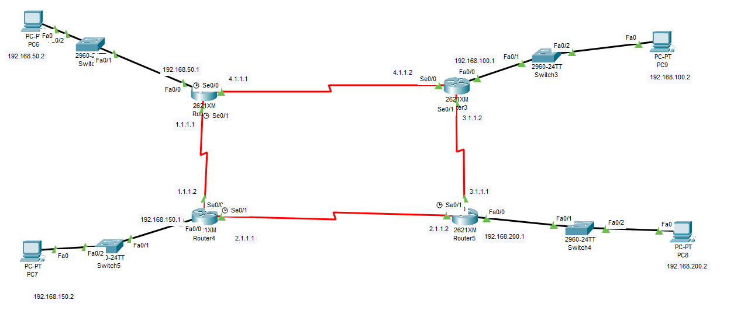
Static Routing Lab
Static Routing Practical 2
R2
R1
R3
R4

Slide 13
Static Routing Lab
#show ip route ➔ Result
R1
Router>enable
Router#configure terminal
Router(config)#interface FastEthernet0/0
Router(config-if)#ip address 192.168.50.1 255.255.255.0
Router(config-if)#no shutdown
Router(config-if)#exit
Router(config)#interface Serial0/0
Router(config-if)#ip address 4.1.1.1 255.0.0.0
Router(config-if)#no shutdown
Router(config-if)#exit
Router(config)#interface Serial0/1
Router(config-if)#ip address 1.1.1.1 255.0.0.0
Router(config-if)#no shutdown
Router(config-if)#exit
Router(config)#ip route 192.168.100.0 255.255.255.0 4.1.1.2
Router(config)#ip route 192.168.100.0 255.255.255.0 1.1.1.2
Router(config)#ip route 192.168.150.0 255.255.255.0 1.1.1.2
Router(config)# ip route 192.168.150.0 255.255.255.0 4.1.1.2
Router(config)#ip route 192.168.200.0 255.255.255.0 4.1.1.2
Router(config)#ip route 192.168.200.0 255.255.255.0 1.1.1.2
R2
Router>enable
Router#configure terminal
Router(config)#interface FastEthernet0/0
Router(config-if)#ip address 192.168.100.1 255.255.255.0
Router(config-if)#no shutdown
Router(config-if)#exit
Router(config)#interface Serial0/0
Router(config-if)#ip address 4.1.1.2 255.0.0.0
Router(config-if)#no shutdown
Router(config-if)#exit
Router(config)#interface Serial0/1
Router(config-if)#ip address 3.1.1.2 255.0.0.0
Router(config-if)#no shutdown
Router(config-if)#exit
Router(config)#ip route 192.168.50.0 255.255.255.0 4.1.1.1
Router(config)#ip route 192.168.50.0 255.255.255.0 3.1.1.1
Router(config)#ip route 192.168.150.0 255.255.255.0 3.1.1.1
Router(config)#ip route 192.168.150.0 255.255.255.0 4.1.1.1
Router(config)#ip route 192.168.200.0 255.255.255.0 3.1.1.1
Router(config)#ip route 192.168.200.0 255.255.255.0 4.1.1.1
Destination
Next Hop
Router(config)#ip route 192.168.100.0 255.255.255.0 4.1.1.2

Slide 14
Static Routing Lab
R3
Router>enable
Router#configure terminal.
Router(config)#interface FastEthernet0/0
Router(config-if)#ip address 192.168.150.1 255.255.255.0
Router(config-if)#no shutdown
Router(config-if)#exit
Router(config)#interface Serial0/0
Router(config-if)#ip address 1.1.1.2 255.0.0.0
Router(config-if)#no shutdown
Router(config-if)#exit
Router(config)#interface Serial0/1
Router(config-if)#ip address 2.1.1.1 255.0.0.0
Router(config-if)#no shutdown
Router(config-if)#exit
Router(config)#ip route 192.168.50.0 255.255.255.0 1.1.1.1
Router(config)#ip route 192.168.50.0 255.255.255.0 2.1.1.2
Router(config)#ip route 192.168.100.0 255.255.255.0 1.1.1.1
Router(config)#ip route 192.168.100.0 255.255.255.0 2.1.1.2
Router(config)#ip route 192.168.200.0 255.255.255.0 2.1.1.2
Router(config)#ip route 192.168.200.0 255.255.255.0 1.1.1.1
R4
Router> enable
Router# configure terminal
Router(config)# interface FastEthernet0/0
Router(config-if)# ip address 192.168.200.1 255.255.255.0
Router(config-if)# no shutdown
Router(config-if)# exit
Router(config)# interface Serial0/0
Router(config-if)# ip address 2.1.1.2 255.0.0.0
Router(config-if)# no shutdown
router(config-if)# exit
Router(config)# interface Serial0/1
Router(config-if)# ip address 3.1.1.1 255.0.0.0
Router(config-if)# no shutdown
Router(config-if)# exit
Router(config)#ip route 192.168.50.0 255.255.255.0 2.1.1.1
Router(config)#ip route 192.168.50.0 255.255.255.0 3.1.1.2
Router(config)#ip route 192.168.100.0 255.255.255.0 3.1.1.2
Router(config)#ip route 192.168.100.0 255.255.255.0 2.1.1.1
Router(config)#ip route 192.168.150.0 255.255.255.0 3.1.1.2
Router(config)#ip route 192.168.150.0 255.255.255.0 2.1.1.1
#show ip route ➔ Result

Slide 15
Static Routing Lab
The default administrative distance of a static route is 1
The administrative distance (AD) is a value used by routers to determine the trustworthiness of a route. Lower values are preferred. Static routes typically have an AD of 1, which is considered highly reliable, whereas dynamic routing protocols like RIP, OSPF, and EIGRP have higher administrative distances.
However, it's important to note that the AD of a static route can be adjusted if needed. For instance, if you want a static route to be used only as a backup when other routes are unavailable, you can configure its AD to a higher value. This practice is known as configuring a floating static route.
Route Type | Administrative Distance
Directly Connected | 0
Static Route | 1
EIGRP (Internal) | 90
EIGRP (External) | 170
RIP | 120
OSPF | 110
Static Route (Floating) | 250 (usually set manually)
External BGP (eBGP) | 20
Internal BGP (iBGP) | 200

Slide 16
Floating static route:
A floating static route is a static route with a higher administrative distance than the primary route. It acts as a backup and is used only when the primary route fails (becomes unavailable).
How to configure a floating static route?
Primary Static Route:
ip route 192.168.100.0 255.255.255.0 3.1.1.2
Floating Static Route (higher administrative distance, e.g., 250):
ip route 192.168.100.0 255.255.255.0 2.1.1.1 250

Slide 17
Default Route
A default route is used in the following scenarios:
Routing for Unknown Destinations:
  A default route is configured to handle traffic destined for unknown networks.
  This is commonly used in scenarios like internet access, where specific destination addresses (e.g., Yahoo's server IP) may not be explicitly listed in the routing table.
End Location Configuration (Optional):
  A default route can be configured at the edge of a network to direct traffic toward a specific next-hop router or gateway.
Benefits of Default Routes:
Simplifies network configuration by reducing the size of the routing table.
Eliminates the need for manually adding routes for every external network.
Example Configuration:
R1(config)# ip route 0.0.0.0 0.0.0.0 10.0.0.2
0.0.0.0 0.0.0.0 represents the default route.
10.0.0.2 is the next-hop IP address or the exit interface through which the traffic is forwarded.

Slide 18
Default Route
For example, imagine you have three routers (R1, R2, and R3) connected to each other, and static routing is configured on all of them. R3 is further connected to an ISP.
Each router's LAN is connected to a switch, and each switch has four computers connected to it.
If a computer in this network wants to access a website like Yahoo.com, which is located on the internet with an IP address (e.g., 202.148.35.137), the following process occurs:
The computer sends the packets to its switch.
The switch forwards the packets to the connected router.
The router checks its routing table to see if there is an entry for this destination (202.148.35.137).
If no entry exists, the router will drop the packet because it doesn’t know where to forward it.
To make Yahoo.com accessible, you need to add a route in the router for Yahoo's IP address.
R1(config)# ip route 202.148.35.137 255.255.255.255 2.2.2.2
However, if another computer wants to access Google.com, you would need to add another route for Google's IP address. Similarly, for every new destination, you would have to manually add a static route. This can quickly become hard and slow.
Destination
Next Hop

Slide 19
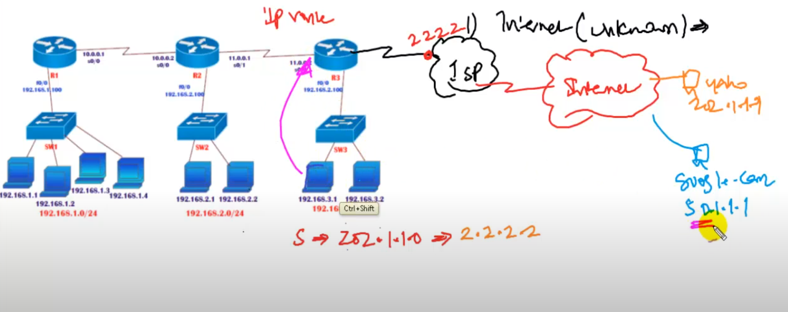
Default Route

Slide 20
Default Route
Now, the question is: how many static routes can you add?
There are thousands of networks, and it’s not practical to write a static route for each and every one.
It’s simply not possible.
So, what should we do in this situation? What's the alternative solution?
The alternative is called Default Routing.
R3(config)# ip route 0.0.0.0 0.0.0.0 2.2.2.2
0.0.0.0 represents any destination.
0.0.0.0 represents any subnet.
2.2.2.2 Next hope
By adding this default route, when traffic reaches the router and there is no specific entry for the destination in the routing table, the router will forward the traffic to 2.2.2.2 instead of dropping the packet.

Slide 21
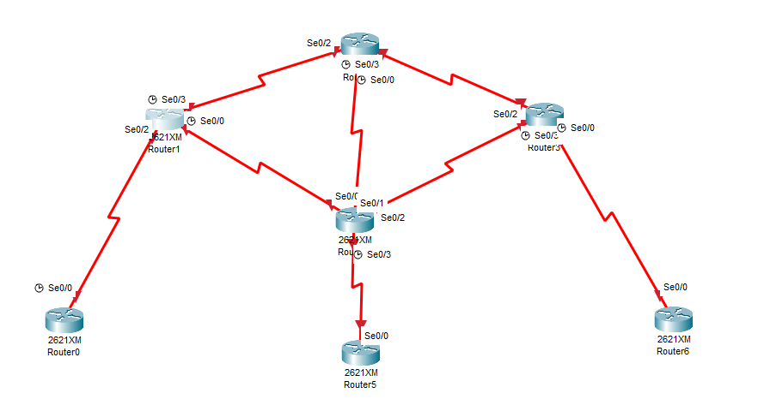
Default Route
For End Location , Scenario
From Router E, the next hop is Router A.
If you want to go to any destination, the traffic will go via Router A:
A via A
B via A
C via A
D via A
F via A
G via A
In this situation, Router E acts as the end location. To simplify the configuration and minimize the size of the routing table, you can add a default route on Router E. This way, there’s no need to add static routes for every destination at the end location.
RouterE(config)# ip route 0.0.0.0 0.0.0.0 1.1.1.2
Router B
Router A
Router C
Router D
Router E
Router G
Router F
Destination
Any Subnet
Next Hope
Router A

Slide 22
Default Route
Note: Default routes cannot be added on Router A, B,C D
They are only suitable at end locations, such as Router E, Router F, and Router G.
This allows traffic to be forwarded to the next hop without adding static routes for every destination.
Note: All other routers must know the path of Router E, and Router E must have only one default route.
Router B
Router A
Router C
Router D
Router E
Router G
Router F

Slide 23
Dynamic routing Protocols
✅ What is a Dynamic Routing Protocol?
A dynamic routing protocol is a way for routers to automatically find the best path to send data in a network.
Routers talk to each other and share information.
They automatically update routes if the network changes (like a link breaks).
You don’t need to set routes manually.

Slide 24
Dynamic routing Protocols
Dynamic routing protocols are divided into two categories: IGP and EGP.
✅ IGP (Interior Gateway Protocol):
Used inside a single organization or company.
Helps routers within the same network talk to each other.
IGP protocols run within an Autonomous System
Examples: OSPF, EIGRP, RIP, IS-IS
✅ EGP (Exterior Gateway Protocol):
Used to connect different organizations’ networks (Autonomous Systems).
Helps routers from different companies or ISPs to communicate.
EGP protocols connect different Autonomous Systems.
Example: BGP

Slide 25
Dynamic routing Protocols
💡 What is an Autonomous System (AS)?
An Autonomous System (AS) is a group of connected networks managed by one organization (like a company or ISP).
🏢 Example of IGP and EGP:
Company A has offices in New York, London, and Dubai
All their offices are connected through routers and private networks.
This entire setup is managed by Company A’s IT team.
This is one Autonomous System (AS).
The routers inside Company A’s network use IGP protocols like OSPF or EIGRP to talk to each other
Now
Company A needs to send data to Google or Facebook (which are separate companies with their own networks and Autonomous System).
To do this, Company A’s routers must communicate with the routers of Google or Facebook.
This is done using EGP protocols, like BGP, which connect different Autonomous systems (Company A ↔ Google ↔ Facebook).

Slide 26
How Routing Protocols Choose the Best Path
RIP (Routing Information Protocol):
✔ Metric = Hop Count
✔ Chooses path with fewest hops
OSPF (Open Shortest Path First):
✔ Metric = Cost (based on bandwidth)
✔ Chooses path with highest bandwidth / lowest cost
EIGRP (Enhanced Interior Gateway Routing Protocol):
✔ Metric = Composite (Bandwidth + Delay)
✔ By default: lowest delay & highest bandwidth path
IS-IS (Intermediate System to Intermediate System):
✔ Metric = Cost (similar to OSPF, based on bandwidth)
✔ Chooses path with lowest cost
BGP (Border Gateway Protocol):
✔ Metric = Path Attributes (main one = AS-Path)
✔ Chooses path with fewest Autonomous Systems (AS hops)

Slide 27
Classification of Dynamic Routing Protocols
Distance Vector Protocols:
Choose the best path based on distance (number of hops).
Routers share their routing table with neighbors.
Sends periodic update , It sends updates all the time
Example: RIP
Link State Protocols:
Routers build a complete map of the network.
They use algorithms (like Dijkstra) to find the shortest path.
Routers share link information with all routers.
Sends incremental update, It only update when the new changes occurs
Example: OSPF
Path Vector Protocols:
Use the full path (not just distance) to reach a destination.
Routers share the entire route with neighbors.
Used between large networks (like the internet).
Example: BGP
BGP choose best path = AS-Path (number of Autonomous Systems)
Path 1: AS 100 → AS 200 → AS 300 (3 AS hops) Path 2: AS 100 → AS 400 (2 AS hops)
BGP will prefer Path 2 because it has fewer AS hops.
Hybrid Protocols:
Mix features of both distance vector and link state.
Easier to use, more scalable, and flexible.
Example: EIGRP

Slide 28
Dynamic routing Protocols
Distance Vector Protocols
1. RIP (Routing Information Protocol)
Administrative Distance (AD): 120
Used for: Small to medium-sized networks.
Metric: Hop count (maximum of 15 hops).
Link-State Protocols
1. OSPF (Open Shortest Path First)
AD: 110
Used for: Larger networks and scalable environments.
Metric: Cost (based on link bandwidth).
2. IS-IS (Intermediate System to Intermediate System)
Administrative Distance (AD):
Used for: Large-scale enterprise and service provider networks.
Used on ISP Side
Metric: Cost (similar to OSPF but uses different algorithm)

Slide 29
Dynamic routing Protocols
Path Vector Protocols
BGP (Border Gateway Protocol)
AD: 20 (eBGP), 200 (iBGP)
Used for: Inter-domain routing, primarily for large-scale networks like the internet.
Metric: AS path (path through autonomous systems).
Type: Exterior Gateway Protocol (EGP), used between different autonomous systems
Hybrid Protocol
EIGRP (Enhanced Interior Gateway Routing
Protocol)AD: 90 (internal), 170 (external)
Used for: Medium to large networks. Cisco-based networks.
Metric: Uses bandwidth, delay, load, and reliability in its metric to calculate the best path.
Protocol | Routing Type | Administrative Distance (AD) | Metric Type
RIP | Distance Vector | 120 | Hop count
EIGRP | Hybrid (Distance Vector/Link-State) | 90 (internal), 170 (external) | Bandwidth, delay, load, reliability
OSPF | Link-State | 110 | Cost (based on bandwidth)
IS-IS | Link-State | 115 | Cost
BGP | Path Vector | 20 (eBGP), 200 (iBGP) | AS path

Slide 30
Dynamic routing Protocols
Difference between hope and metric
🔹 Hop
A hop = one router the packet passes through.
It’s basically “how many routers are in the path” from source to destination.
Example: If a packet goes through 3 routers → 3 hops.
🔹 Metric
A metric = a value routers use to choose the best path.
It’s like a score or cost for the route.
Depends on the routing protocol:
RIP → metric = hop count
OSPF → metric = bandwidth (cost)
EIGRP → metric = bandwidth + delay (and more factors)

Slide 31
Difference between Classless and Classful routing Protocols
Classful Routing Protocol
Uses default subnet masks based on IP classes (A, B, C).
Doesn't include subnet mask in routing updates.
Example: RIPv1.
Classless Routing Protocol:
Allows any subnet mask, not just the default.
Includes subnet mask in routing updates.
Example: OSPF, EIGRP.

Slide 32
Understanding Single Area and Multi-Area OSPF with Backbone (Area 0)
✅ Single Area OSPF
All routers are in one big area called Area 0 (the backbone area).
All routers share full routing information with each other inside this single area.
Easy to set up but can get slow and complex if the network grows very large.
Example: A small office network with 10 routers, all in Area 0, connected in a single OSPF domain.
✅ Multiple Areas OSPF
The network is divided into several smaller areas.
These areas connect to a central Area 0 (backbone area).
Routers share detailed routing info inside their own area but summarized info between areas.
This reduces the workload on routers and improves performance in large networks
Example:
A company has:
Head Office with 20 routers in Area 0 (backbone).
Branch 1 with 10 routers in Area 1.
Branch 2 with 15 routers in Area 2.
Each branch connects to Area 0 via an ABR (Area Border Router).

Slide 33
Is Area 0 Necessary in OSPF? Can You Use Any Area Like Area 30?
✅ Yes, you can use any area number like Area 30, Area 10, etc.
Area 0 is always required as the Backbone Area.
OSPF requires Area 0 to connect multiple areas.
All other areas (e.g., Area 30) must connect to Area 0 either directly or virtually.
If you use only one area (single area OSPF), it is best practice to use Area 0.
✅ Conclusion:
You can type any area number like area 30.
If you configure Area 10 and Area 30, but do not have Area 0, OSPF won’t work properly.
Area 0 is necessary in OSPF design to interconnect multiple areas.

Slide 34
Using One OSPF Area for All Branches: Good or Bad?
✅ If You Use the Same Area (e.g., Area 0) for Islamabad, Lahore, and Karachi:
You are using Single Area OSPF.
All routers share full routing information with each other.
There is no route summarization.
It works well for small or simple networks.
Easy to configure and manage.
❌ Drawbacks in Large Networks:
High CPU and memory usage on routers.
Slower convergence time.
Hard to manage when the network grows.
Less efficient in handling routing updates
✅ Conclusion:
For multiple remote locations, it's better to use multiple areas, connected via Area 0.

Slide 35
Configure and Verify Single Area OSPF
OSPF (Open Shortest Path First):
OSPF is a classless routing protocol, supporting both VLSM and FLSM.
It is a link-state routing protocol, meaning it selects the best path based on bandwidth (preferring higher bandwidth paths).
Incremental updates: OSPF shares routing information only when there is a change.
Can connect an unlimited number of routers.
The OSPF metric is called cost, calculated as 10^8 / sum of bandwidth.
Uses the SPF algorithm (Shortest Path First) to calculate the best route.
Each OSPF process has a Process ID (range: 1–65535) to create separate OSPF domains.
OSPF uses a wildcard mask (WCM) to define network addresses.
Area ID: OSPF can operate in single-area or multi-area setups. Area 0 is the backbone area.
OSPF creates three tables:
  Neighbor Table
  Database Table
  Routing Table

Slide 36
Configure and Verify Single Area OSPF
What is a Wildcard Mask?
A wildcard mask tells the router which IP addresses to match and which parts to ignore.
0 = must match exactly
255 = can be anything
Example: 192.168.1.0 0.0.0.255 → match all IPs from 192.168.1.0 to 192.168.1.255
Why OSPF Uses a Wildcard Mask?
Other routing protocols like RIP and EIGRP are simple , they only need the network name, for example:
network 192.168.1.0. They automatically know which interfaces belong to that network.
But OSPF is more detailed and stricter, interface-based. It doesn’t guess , it wants to know exactly which interfaces to include.
So, we use:
network 192.168.1.0 0.0.0.255 area 0
This tells OSPF the exact range of IPs it should look for.
How OSPF Uses It
When you configure OSPF globally like this:
router ospf 1
network 1.0.0.0 0.255.255.255 area 0
network 192.168.1.0 0.0.0.255 area 0
Router checks all interface on itself , It compares each interface’s IP with your network wildcard mask. If an interface IP fits inside that range , OSPF automatically activates on that interface
1.0.0.0 0.255.255.255 matches 1.1.1.1 → ✅ Serial0/0 joins OSPF
192.168.1.0 0.0.0.255 matches 192.168.1.1 → ✅ FastEthernet0/0 joins OSPF
OSPF then activates on those interfaces and starts sending Hello packets.

Slide 37
Configure and Verify Single Area OSPF
Note:
RIP , EIGRP and OSPF “all look around” at all interfaces to find which ones belong to the network you mentioned
The only difference is that
RIP/EIGRP don’t need wildcard mask , they use the network address directly
OSPF needs wildcard mask , its more exact and stricter

Slide 38
Configure and Verify Single Area OSPF
Wildcard Mask calculation:
Example 1:
Global Subnet Mask - Sub netmask
255.255.255.255 - 255.255.255.248 = 0.0.0.7
0.0.0.7 is the wildcard mask
Example 2
Subnet Mask = 255.255.255.0
255.255.255.255 - 255.255.255.0 = 0.0.0.255
0.0.0.255 is the wildcard mask

Slide 39
Configure and Verify Single Area OSPF
Understanding OSPF Interface Configuration
FastEthernet0/0 → IP: 192.168.1.1 /24
You want to enable OSPF on this interface
Router(config)# router ospf 1
Router(config)# interface fastethernet0/0
Router(config-if)# ip ospf 1 area 0
Now OSPF will run on this interface and it belongs to area 0.
The router already knows that Fa0/0 has IP 192.168.1.1 with subnet mask 255.255.255.0.
So, it doesn’t need you to tell it the range again (no wildcard mask needed).
It starts sending OSPF Hello packets from that interface.
Why no wildcard mask here?
Because the router is already standing on the exact interface , it knows its IP and mask, so it doesn’t need to search for it. Wildcard masks are only needed when you use the global method

Slide 40
Configure and Verify Single Area OSPF
How routers make neighborhood ?
Routers check these details to become OSPF neighbors:
1️⃣ Same Area ID
Both routers must be in the same area (e.g., Area 0)
2️⃣ Same Subnet (must be directly connected)
They must be directly connected and in the same subnet (e.g., 192.168.1.0/24).
3️⃣ Same Hello timer
It’s the time interval at which an OSPF router sends Hello packets to its neighbors.
Default: 10 seconds ,
Think of it like saying “Hey, I’m alive!” every 10 seconds.
4️⃣ Same Dead timer
It’s the time a router waits without hearing any Hello from a neighbor before declaring it dead.
Default: 40 seconds (4 times the Hello time).
5️⃣ Same Authentication (if used)
Passwords or keys for OSPF, Must match on both routers (same password).
6️⃣ Same Network type (like broadcast, point-to-point, etc.)
Must be same on both sides so they talk properly.
7️⃣ Unique Router IDs (must not be same)
Unique ID of each router (like a name)Must be different (can’t be same).

Slide 41
Configure and Verify Single Area OSPF
What is OSPF Database?
The OSPF database is like a map or record book inside each router that stores all the link and network information collected from OSPF neighbors.
1️⃣ Each router tells others about its links using LSAs (Link-State Advertisements) — like saying, “Hey, I’m Router1 and I’m connected to Network A and Router2.”
2️⃣ All routers share their LSAs with each other.
3️⃣ Each router stores all received LSAs in its OSPF database (LSDB).
4️⃣ Then each router uses this LSDB to calculate the best paths using the Dijkstra algorithm (SPF algorithm).
The OSPF database is the router’s collection of all network information it learned from neighbors ;it’s used to build the routing table.
The OSPF database is like a map of the whole network that every router keeps. They all share and update this map so everyone knows the same routes.

Slide 42
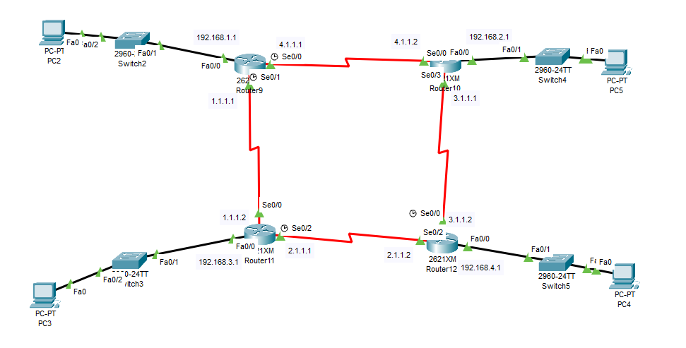
Configure and Verify Single Area OSPF
R1
R2
R3
R4

Slide 43
Configure and Verify Single Area OSPF
R1
Router> enable
Router# configure terminal
Router(config)# interface FastEthernet0/0
Router(config-if)# ip address 192.168.1.1 255.255.255.0
Router(config-if)# no shutdown
Router(config-if)# exit
Router(config)# interface Serial0/0
Router(config-if)# ip address 4.1.1.1 255.0.0.0
Router(config-if)# no shutdown
Router(config-if)# exit
Router(config)# interface Serial0/1
Router(config-if)# ip address 1.1.1.1 255.0.0.0
Router(config-if)# no shutdown
Router(config-if)# exit
Router(config)# router ospf 30
Router(config-router)# network 4.0.0.0 0.255.255.255 area 0
Router(config-router)# network 1.0.0.0 0.255.255.255 area 0
Router(config-router)# network 192.168.1.0 0.0.0.255 area 0
Router(config-router)# exit
R2
Router> enable
Router# configure terminal
Router(config)# interface FastEthernet0/0
Router(config-if)# ip address 192.168.2.1 255.255.255.0
Router(config-if)# no shutdown
Router(config-if)# exit
Router(config)# interface Serial0/0
Router(config-if)# ip address 4.1.1.2 255.0.0.0
Router(config-if)# no shutdown
Router(config-if)# exit
Router(config)# interface Serial0/3
Router(config-if)# ip address 3.1.1.1 255.0.0.0
Router(config-if)# no shutdown
Router(config-if)# exit
Router(config)# router ospf 30
Router(config-router)# network 192.168.2.0 0.0.0.255 area 0
Router(config-router)# network 4.0.0.0 0.255.255.255 area 0
Router(config-router)# network 3.0.0.0 0.255.255.255 area 0
Router(config-router)# exit
Check Result :
show ip route ospf
show ip route
Check Result :
show ip ospf neighbor
show ip ospf database

Slide 44
Configure and Verify Single Area OSPF
R3
Router> enable
Router# configure terminal
Router(config)# interface FastEthernet0/0
Router(config-if)# ip address 192.168.3.1 255.255.255.0
Router(config-if)# no shutdown
Router(config-if)# exit
Router(config)# interface Serial0/0
Router(config-if)# ip address 1.1.1.2 255.0.0.0
Router(config-if)# no shutdown
Router(config-if)# exit
Router(config)# interface Serial0/2
Router(config-if)# ip address 2.1.1.1 255.0.0.0
Router(config-if)# no shutdown
Router(config-if)# exit
Router(config)# router ospf 30
Router(config-router)# network 1.0.0.0 0.255.255.255 area 0
Router(config-router)# network 2.0.0.0 0.255.255.255 area 0
Router(config-router)# network 192.168.3.0 0.0.0.255 area 0
Router(config-router)# exit
R4
Router> enable
Router# configure terminal
Router(config)# interface FastEthernet0/0
Router(config-if)# ip address 192.168.4.1 255.255.255.0
Router(config-if)# no shutdown
Router(config-if)# exit
Router(config)# interface Serial0/0
Router(config-if)# ip address 3.1.1.2 255.0.0.0
Router(config-if)# no shutdown
Router(config-if)# exit
Router(config)# interface Serial0/2
Router(config-if)# ip address 2.1.1.2 255.0.0.0
Router(config-if)# no shutdown
Router(config-if)# exit
Router(config)# router ospf 30
Router(config-router)# network 192.168.4.0 0.0.0.255 area 0
Router(config-router)# network 3.0.0.0 0.255.255.255 area 0
Router(config-router)# network 2.0.0.0 0.255.255.255 area 0
Router(config-router)# exit
Check Result :
show ip route ospf
show ip route
Check Result :
show ip ospf neighbor
show ip ospf database

Slide 45
Configure and Verify Single Area OSPF
#show ip ospf database
you see information about OSPF LSAs (Link State Advertisements). Each LSA is like a "piece of information" that routers share with each other about the network.
🔹 Link ID
Think of this as the "name" of the network or link being advertised.
It could be a router ID, a network ID, or something else depending on the LSA type.
🔹 ADV Router (Advertising Router)
This is the router ID of the router that created and sent this LSA.
It tells you who is the author of this information.
🔹 Age
How old this information is (in seconds).
LSAs "age out" after 1800 seconds (30 minutes).
If it gets too old, it is refreshed or removed.
🔹 Seq# (Sequence Number)
This is like a version number of the LSA.
Newer LSAs have a higher sequence number.
Routers use this to know which copy of the info is the latest.
🔹 Checksum
This is a kind of "error check" to make sure the LSA wasn’t damaged while traveling through the network.
🔹 Length
This shows how big the LSA is (size in bytes).
Some LSAs have more details, so they are longer.

Slide 46
Configure and Verify Single Area OSPF
LSA = Link State Advertisement
👉 In simple words:
An LSA is a small message that a router creates and shares with other routers to describe part of the network.
Each router in OSPF sends LSAs to tell others things like:
“I am router A, and I’m connected to network 10.1.1.0/24”
“I am router B, and I have a link to Router A with cost 10”
All routers collect these LSAs from each other and put them into the OSPF database. From that database, they build a complete map of the network, and then use it to calculate the best routes.
🔹 Think of LSAs like pieces of a puzzle:
Each router contributes a piece (its own LSA).
When you put all the pieces together, you get the full picture of the network.

Slide 47
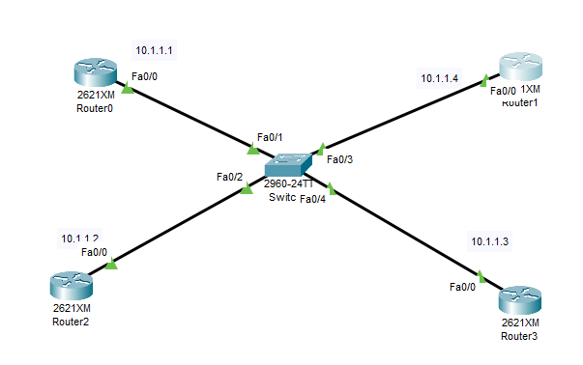
DR and BDR Election, Point to Point , Concept of Router ID
OSPF Without DR and BDR
Increased adjacencies between all routers.
Excessive routing updates.
Higher network congestion.
Reduced efficiency in large networks.
Solution:
The OSPF protocol introduces the concept of DR, BDR, and DR Others to address these issues effectively.
R1
R4
R2
R3

Slide 48
DR and BDR Election, Point to Point , Concept of Router ID
DR (Designated Router), BDR (Backup Designated Router), and DROthers are concepts that belong specifically to OSPF (Open Shortest Path First).
RIP, EIGRP, BGP, IS-IS → They don’t use DR/BDR election.
In networks like OSPF (a routing protocol), when many routers are connected in the same network (like LAN), they need a leader to avoid too much traffic.
DR (Designated Router): Works like the “leader” router. It shares routing information with others.
BDR (Backup Designated Router): Works like the “vice leader.” If the DR fails, BDR takes over.
Other routers just talk to the DR/BDR, not to everyone directly → this reduces chaos.
Election is automatic: routers with highest priority (or highest Router ID if priority ties) become DR, second best becomes BDR.

Slide 49
DR and BDR Election, Point to Point , Concept of Router ID
DR, BDR, and DR Others are roles used in networks like Ethernet to reduce the number of connections between devices and make the network work more efficiently.
DR (Designated Router):The main router that exchanges OSPF information with all other routers in the network. It minimizes unnecessary communication by centralizing updates.
BDR (Backup Designated Router):A backup router that takes over if the DR fails. It ensures network continuity and reliability.
DR Others: All other routers in the network that are neither DR nor BDR. They form adjacencies only with the DR and BDR to keep the communication simple.
Purpose:
Avoid Flooding by having routers communicate only with the DR or BDR if the DR fails.
Reduces the number of OSPF adjacencies.
Ensures efficient routing in networks with multiple routers.

Slide 50
DR and BDR Election, Point to Point , Concept of Router ID
Note:
DR Others do not communicate directly with each other to exchange routing information.
Instead:
DR Others send their routing updates only to the DR (and the BDR, as a backup).The DR then shares the collected routing information with all the routers in the network, including the DR Others.
DR Others → Send updates to DR only.
DR → Distributes updates to all routers, including DR Others.

Slide 51
DR and BDR Election, Point to Point , Concept of Router ID
Election will take place based on the following factors:
Highest Priority
Highest Router ID
Highest Active IP address (if no router ID is set or no loop back IP is set)
Election by Priority:
By default, the priority is set to 1
Election by Priority will tie because of the same priority , we can increase the priority also. So, the router with highest priority will become the DR & second highest priority will become BDR.
We can also manually assign the DR, BDR, and DR Others by changing the priority or assigning a higher IP address.
Router(config)# interface f0/0
Router(config-if)# ip ospf priority ?
Router(config-if)#ip ospf priority 10

Slide 52
DR and BDR Election, Point to Point , Concept of Router ID
Election will take place based on the following factors:
Highest Priority
Highest Router ID
Highest Active IP address (if router ID is not set or no loop back IP is set)
Election by Highest Router ID:
A Router ID is just a unique number/name that identifies a router in OSPF.
Think of it like a “roll number” in class. It looks like an IP address (e.g., 1.1.1.1).
How it is chosen:
If manually set → that is used.
If not set → the highest IP on a loopback interface is used.
If no loopback → the highest active IP address on a normal interface is used.
How to set Router ID manually:
Router> enable
Router# configure terminal
Router(config)# router ospf 1
Router(config-router)# router-id 5.5.5.5
Router(config-router)# exit
If you set Router ID on one Router , Other will be by default like “no Router ID” . So, this router will become the DR

Slide 53
DR and BDR Election, Point to Point , Concept of Router ID
How to check Router ID ?
show ip ospf
Routing Process "ospf 1“ with ID 5.5.5.5
Here 5.5.5.5 is the Router ID

Slide 54
DR and BDR Election, Point to Point , Concept of Router ID
Election will take place based on the following factors:
Highest Priority
Highest Router ID
Highest Active IP address (if router ID is not set or no loop back IP is set)
Election by Highest Active IP address (if no loop back IP is set):
OSPF looks for a loopback interface.
It picks the highest IP address on a loopback.
If no loopback exists: It picks the highest active IP address on normal interfaces (like Fa0/0, Fa0/1, etc).
if Fa0/0 has the highest IP address among all active interfaces and no loopback or manual Router ID is set, then Fa0/0’s IP will be used as the Router ID.

Slide 55
DR and BDR Election, Point to Point , Concept of Router ID
What is loopback IP?
A loopback IP is an IP address you assign to a virtual interface inside the router (not a physical port).
It never goes down as long as the router is on
Used for Router ID or testing connectivity.
OSPF often uses it as the Router ID because it is always stable.
Router(config)# interface loopback0
Router(config-if)# ip address 10.10.10.1 255.255.255.255
If you manually set the Router ID (e.g., 5.5.5.5), that value will always be used, no matter what loopback or interface IPs exist.
Final Router ID = 5.5.5.5

Slide 56
DR and BDR Election, Point to Point , Concept of Router ID
🔹 Process of Election
Routers on the network send Hello packets.
These packets contain information like Router ID and Priority.
OSPF checks the Priority first.
Each router interface has an OSPF priority value (0–255).
The highest priority wins the DR election.
If a router has priority 0, it can never be DR/BDR.
If priorities are the same → Router ID decides.
The router with the highest Router ID becomes the DR. The second highest becomes the BDR.
If Router ID is not manually set
Otherwise, the highest IP on any loopback.
Otherwise, the highest IP on any active physical interface (like Fa0/0).
Election is not preemptive
Once a DR and BDR are chosen, they stay until one fails or the OSPF process restarts.
A new “better” router joining later won’t automatically take over.

Slide 57
DR and BDR Election, Point to Point , Concept of Router ID
R1
Router(config)# interface FastEthernet0/0
Router(config-if)# ip address 10.1.1.1 255.0.0.0
Router(config-if)# no shutdown
Router(config-if)# exit
Router(config)# router ospf 40
Router(config-router)# network 10.0.0.0 0.255.255.255 area 0
Router(config-router)# exit
R3
Router(config)# interface FastEthernet0/0
Router(config-if)# ip address 10.1.1.3 255.0.0.0
Router(config-if)# no shutdown
Router(config-if)# exit
Router(config)# router ospf 40
Router(config-router)# network 10.0.0.0 0.255.255.255 area 0
Router(config-router)# exit
R2
Router(config)# interface FastEthernet0/0
Router(config-if)# ip address 10.1.1.2 255.0.0.0
Router(config-if)# no shutdown
Router(config-if)# exit
Router(config)# router ospf 40
Router(config-router)# network 10.0.0.0 0.255.255.255 area 0
Router(config-router)# exit
R4
Router(config)# interface FastEthernet0/0
Router(config-if)# ip address 10.1.1.4 255.0.0.0
Router(config-if)# no shutdown
Router(config-if)# exit
Router(config)# router ospf 40
Router(config-router)# network 10.0.0.0 0.255.255.255 area 0
Router(config-router)# exit
Result: show ip ospf neighbor

Slide 58
DR and BDR Election, Point to Point , Concept of Router ID
✅ Summary (To the Point & Simple):
OSPF does not change DR/BDR automatically when you change priority.
DR/BDR are elected when OSPF starts.
To make R2 the new DR (since it has higher priority), you must: Run this command on both routers:
clear ip ospf process
Or
shut and no shut the interfaces to reset OSPF.
After reset, OSPF will re-elect DR/BDR, and R2 (priority 255) will become DR

Slide 59
DR and BDR Election, Point to Point , Concept of Router ID
Point to Point:
A point-to-point network means a direct connection between two routers (only 2 devices).
Example: One router connected to another with a serial link. Since there are only two routers, no DR/BDR election is needed (because they can directly talk to each other without confusion).
DR, BDR, and DROthers are only elected on a multi-access network (like when multiple routers are connected to the same switch
DR, BDR, DR-Other happen when many routers share the same network (like through a switch).

